Slide 1
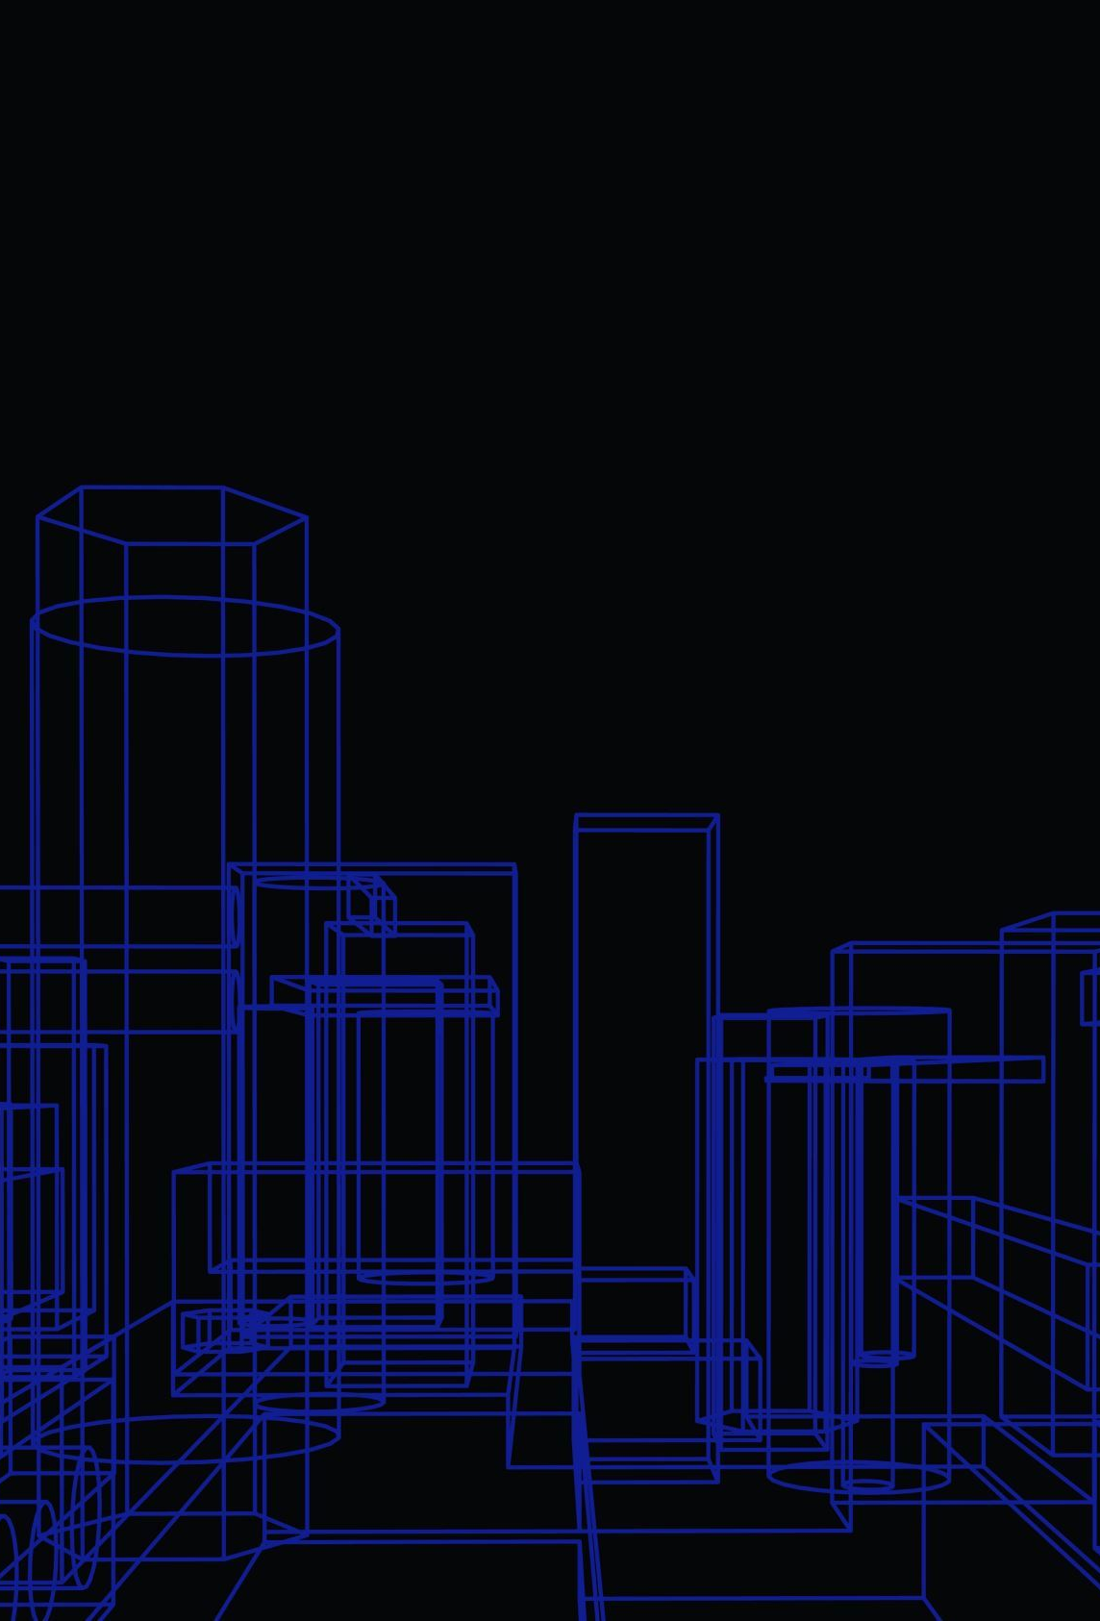
ChatGPT in Software Development
Introduction
What is ChatGPT?
Uses in Software Development
Advantages of ChatGPT
Challenges and Limitations
Conclusion

Slide 2
INTRODUCTION
Let's Imagine a scenario where machines can understand human language and respond in a natural, conversational manner. That's exactly what ChatGPT does, and it's changing the game for businesses everywhere.
As developers, we're constantly looking for ways to improve our products and create better experiences for our users. ChatGPT offers a unique solution to some of the biggest challenges facing software development today, from customer support to natural language processing.

Slide 3
WHAT IS CHATGPT?
ChatGPT is an artificial intelligence-based chatbot technology that uses deep learning algorithms to generate human-like responses to text-based queries.
It is based on GPT (Generative Pre-trained Transformer) architecture, which is a type of neural network that has been pre-trained on large amounts of data to generate natural language output.
This process involves several layers of processing, including tokenization, encoding, and decoding, which work together to generate a coherent and meaningful response.

Slide 4
USES IN SOFTWARE DEVELOPMENT
Common use case is for chatbots, where ChatGPT can help to create more natural and engaging conversations with users. By using ChatGPT, chatbots can understand the intent behind user messages and respond appropriately, leading to a better user experience.
Another area where ChatGPT can be useful is in automated customer support. With ChatGPT, companies can provide 24/7 support without the need for human intervention. This can save time and money while still providing high-quality support to customers.

Slide 5
ADVANTAGES OF CHATGPT
In addition, ChatGPT can be used for natural language processing, which enables software to understand and interpret human language.
This is particularly useful for chatbots, as it allows them to provide more accurate and relevant responses to customer inquiries.
Studies have shown that implementing chatbots powered by ChatGPT can lead to a significant increase in customer satisfaction.

Slide 6
CHALLENGES AND LIMITATIONS
One of the main challenges of using ChatGPT in software development is the ethical concerns surrounding the technology.
As AI becomes more advanced, there is a risk that it could be used to manipulate people.
For example, an AI chatbot could be programmed to give biased or misleading information to customers. To address this challenge, developers need to ensure that their use of ChatGPT is transparent and ethical.
Accuracy issues are another limitation of using ChatGPT in software development. While the technology has made significant strides in recent years, it still tends to errors and misunderstandings. This can be particularly problematic in situations where accuracy is crucial, such as medical diagnosis or legal advice.

Slide 7
CHATGPT / GOOGLE
Feature | Chatgpt | Google
Knowledge limitation | Till 2021 | Updated
Accuracy | High, but may not always have the most current information | High can get required information
Format of output | Text-based | Text, voice, and visual
Usability | More search request is need to get relevant information | All relevant informations will be provided when user searches
Working Principle | Based on algorithm | Based on keywords

Slide 8
CONCLUSION
ChatGPT is a powerful tool that has numerous applications in software development.
It can be used for chatbots, automated customer support, and natural language processing, among other things. The advantages of using ChatGPT include increased efficiency, improved customer experience, and reduced costs.
However, there are also challenges and limitations to using ChatGPT, such as ethical concerns, accuracy issues, and language barriers. Despite these challenges, the potential benefits of using ChatGPT make it an important technology to explore further.

